Slide 1

Good practices on collection, management, and use of site monitoring data
Tobias Masina and Fred Fredrick Bangara

Slide 2
Outline
Data collection and management tools
  Summary of Data collection tools
  SPI-RRT dashboard
  Corrective action & standardization register
  Sustenance register
  Task management register
  Quality control, proficiency testing register
  ePT
  Scan form
Data use for gap identification and improvement
Lesson learnt

Slide 3
Summary of data collection tools
Scope | Tool
SPI-RRT audits | Open Data Kit (ODK) SPI-RRT checklist SPI-RRT dashboard
HIV RT CQI mentorship/corrective actions | ODK Mentorship Corrective and Standardization register Task management register
HIV RT Quality control testing, PT result submission, PT report review and Supervision feedback/training | ODK Quality indicators Proficiency testing Onsite supervisory register
Quality indicators | Sustenance register
HIV RT PT surveys | Excel database ePT
Testing data | HTS standard register, Daily activity register scan form

Slide 4
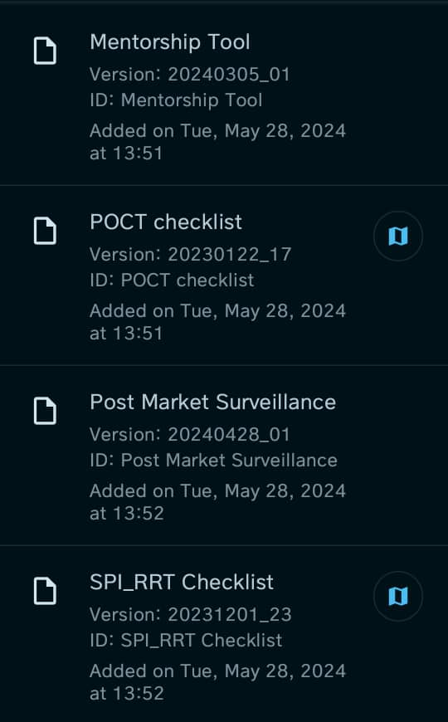
Open Data Kit (ODK) data collection tools
The following tools are used with ODK app
  SPI-RRT checklist
  SPI-POCT Checklist
    HIV VL, EID, CD4, Tb, HPV, Covid 19
  Mentorship tool
    Continuous Professional Development (CPD)
    Site progress toward certification and re-certification
    Invalid & concordance rates, post market surveillance
    PT participation and pass rate
    Tracking of discordant testing
    Progress on corrective actions- implementation, standardization & sustenance
Quality of testing – monthly reporting
  testing, invalid, false positive and negative QCs
  Concordance rate, invalid rate & total positive

Slide 5
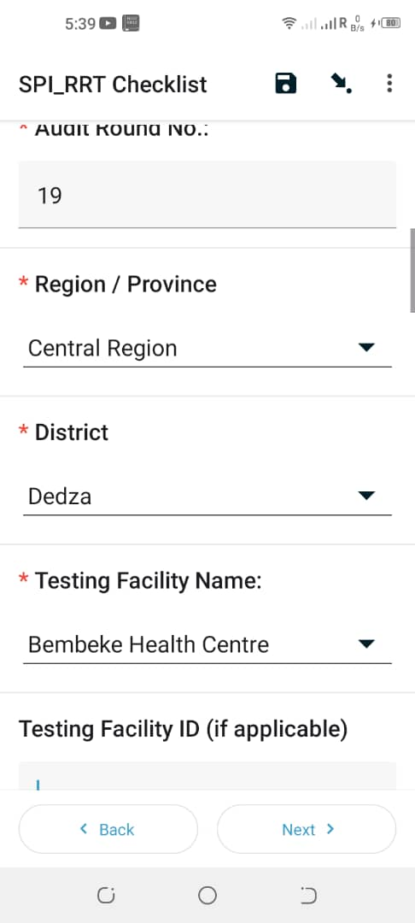
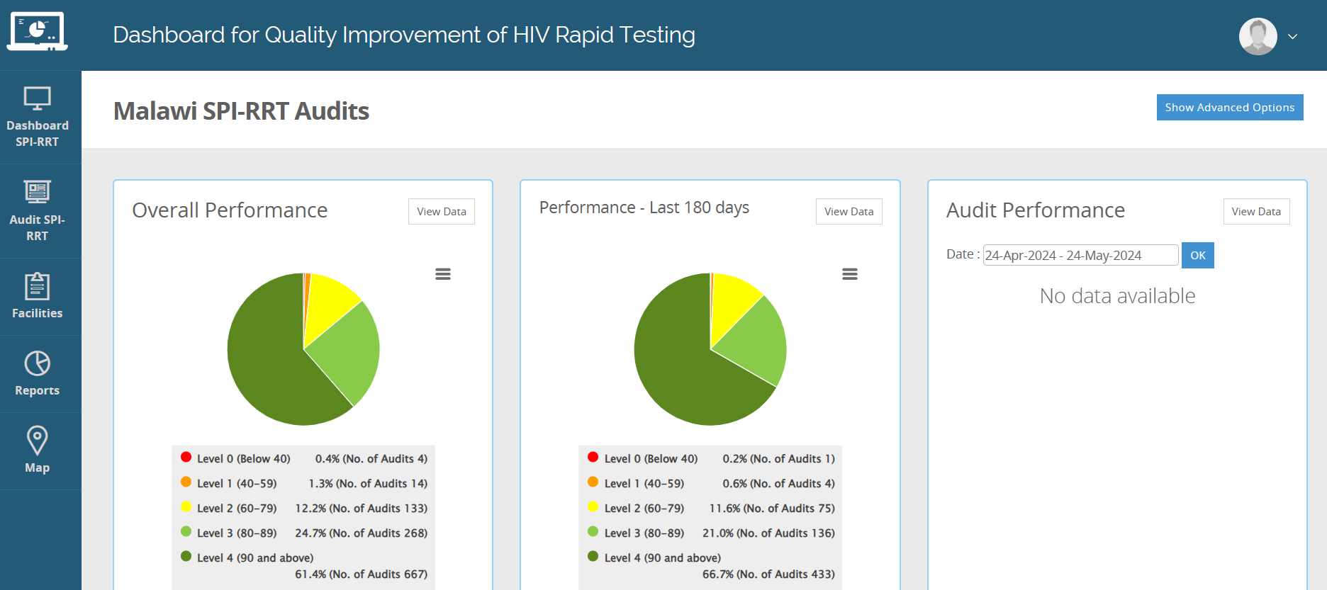
SPI-RRT checklist – dashboard data management
With CDC ILB support, enhanced data collection through drop down list on regions/provinces; districts and testing points
  Improved accuracy of naming of testing points
  Data quality esp. number of testing points
  Tracking of testing point progress
  Efficiency in data collection

Slide 6


Corrective actions data site management
Developed register to manages the continuous quality improvement (CQI) data
  Corrective action section
    Documents gap, corrective action, indicator, baseline, target, progress performance, and outcome
  Standardization section
    Documents activity, indicator, progress performance & outcome for standardization
A hands-on training tool for testers on implementation of corrective actions

Slide 7
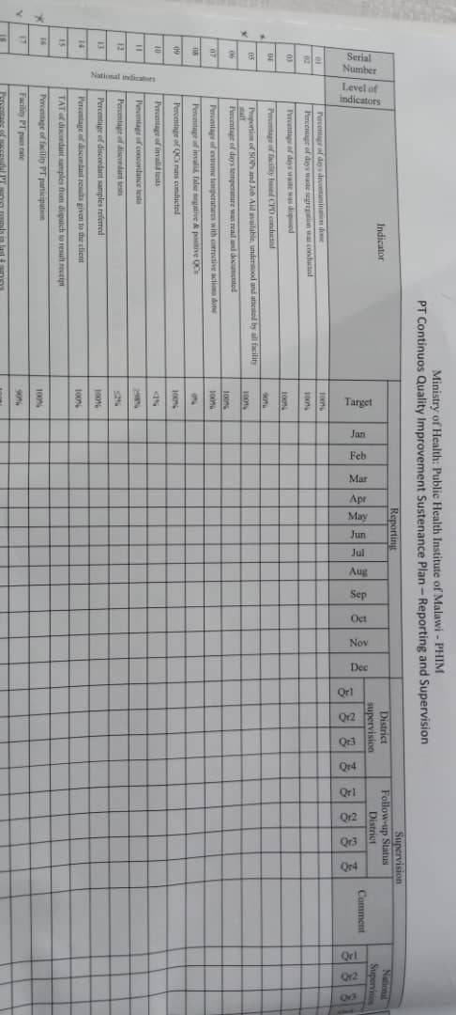
Quality indicators – site monitoring & supervision
Developed a register to monitors monthly performance of facility on selected national and facility indicators
Sustains achieved standard through site monitoring and supervisions
Builds facility capacity and ownership on use of data
Mentorship/supportive supervision tools

Slide 8
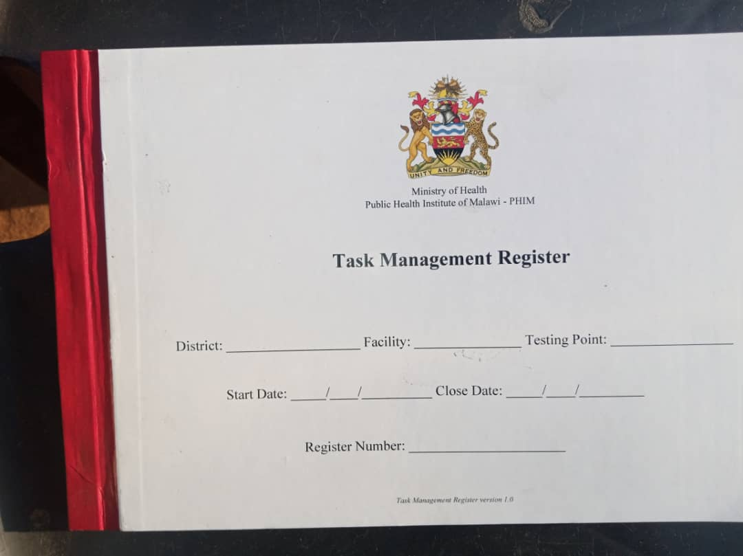
Task management data site management
A register developed to manage and monitor the performance of the following tasks:
  Daily, weekly, monthly, biannual, annual and as-needed tasks
  Preparation of disinfectant and decontamination of work area
  Waste segregation and disposal
  Temperature monitoring
  Implementation of 5S
  Facility based Continuous Professional Development (CPD)
  Archival of records
Ensures availability of documents at a testing point

Slide 9
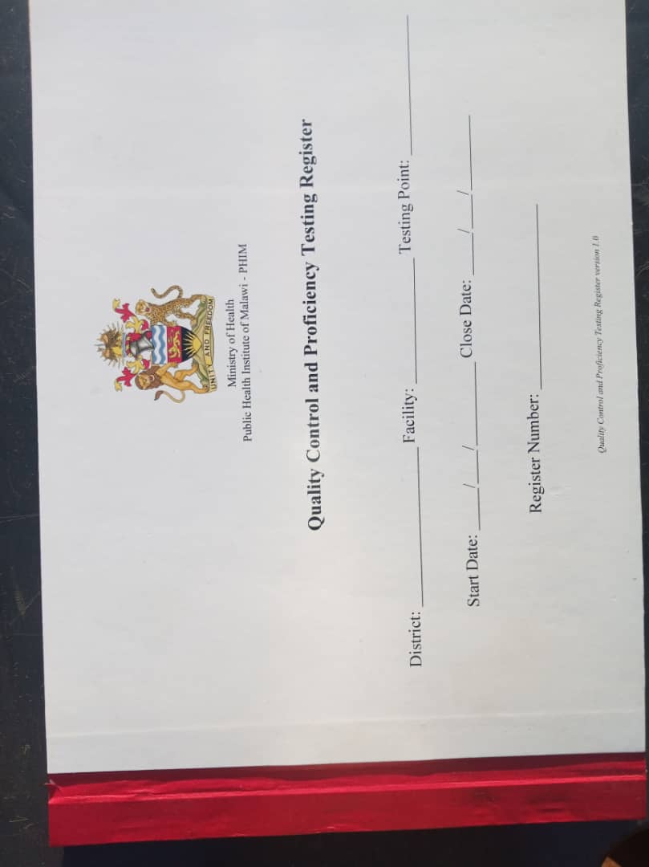
Quality control, Proficiency testing and supervision data site management
Developed to manage and monitor data for quality improvement on
  Quality of testing services
  PT result submission
  PT report review
  Supervision feedback and training

Slide 10
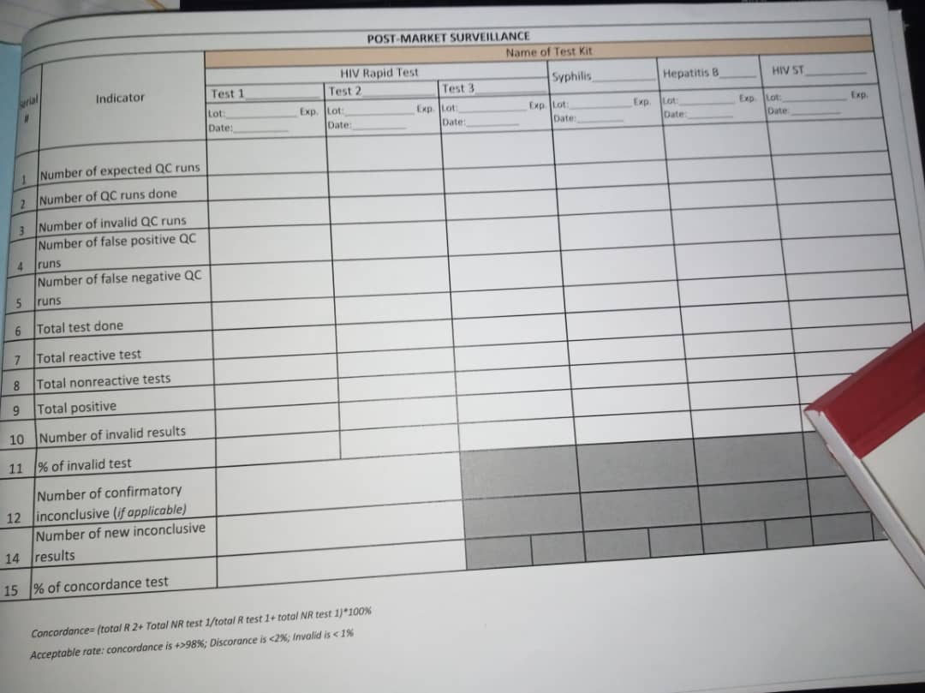
Quality of testing data site management
Manages and monitors data for post market surveillance on
  Quality control testing
  Testing results
  Test kit information
  Invalid results
  Concordance/discordance rate

Slide 11
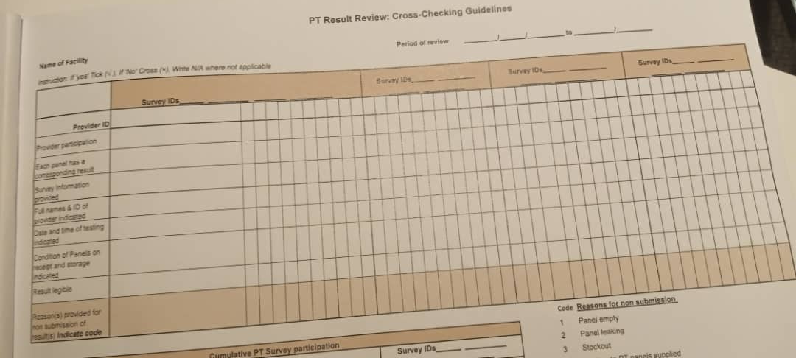
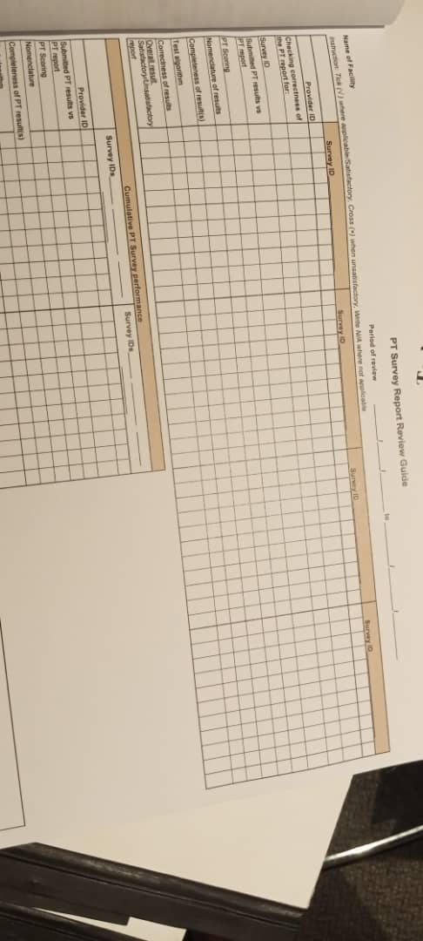
PT result submission & report data site management
PT report review guide is a standard tool for identification of possible problems in PT failure for corrective action
Tracks Testers satisfactory and successful performance in PT surveys at a site
PT result review guide
PT result cross checking guide is a standard tool that
  Tracks testers participation of testers at a site
  Prevents clerical errors and ensures conformity to PT provider’s requirements
  Improves site pass rate
PT report review guide

Slide 12

Site Supervision data management
Tracks number of site supervisions
Tracks implementation of corrective action by site
Effectiveness of supervision, onsite feedback and training

Slide 13
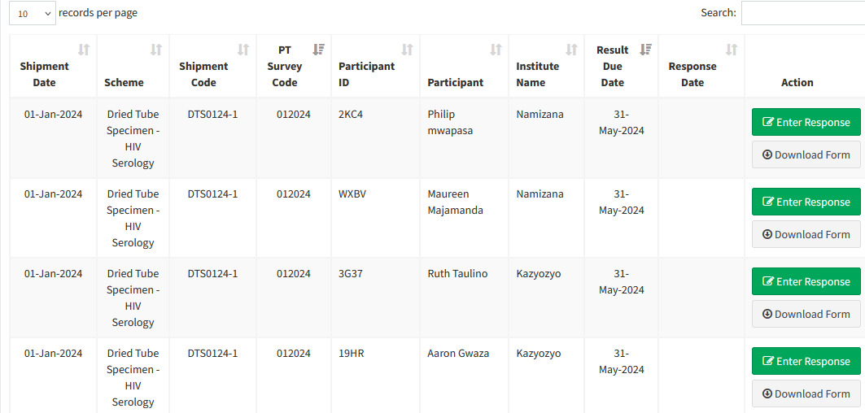
HIV RT ePT data site data management
Support management of Serology PT survey
Monitors site participation and pass rate.
Identifies participant gaps for corrective actions.
Manage testers database and improves PT survey participation and pass rate

Slide 14
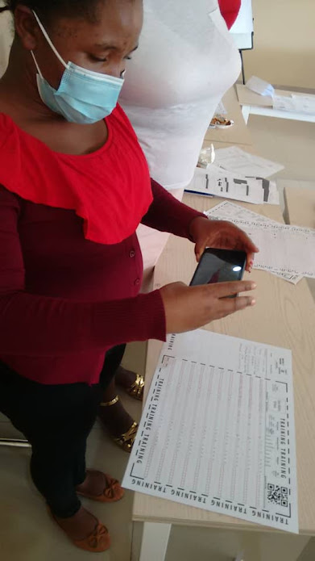
Scan form technology
Supports site reporting of data
  User scans registry with scan phone application
  Provides near real time data for decision making
  Efficient and effective for data quality

Slide 15
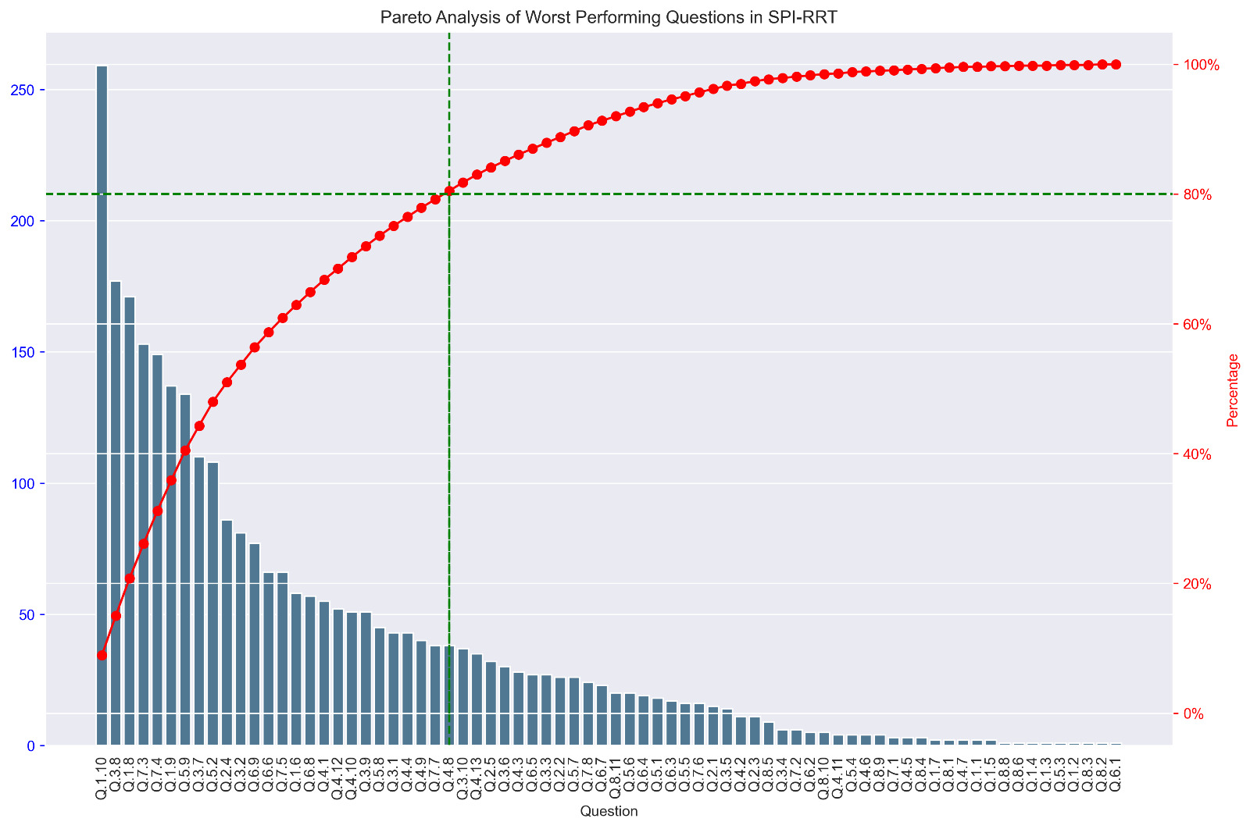
Data use to inform the program- SPI-RRT Poor performance questions
The frequency is used to prioritize the implementation of problem based on the 80/20 rule
Provide more insights to the problem and assessment
Efficient and effective approach

Slide 16
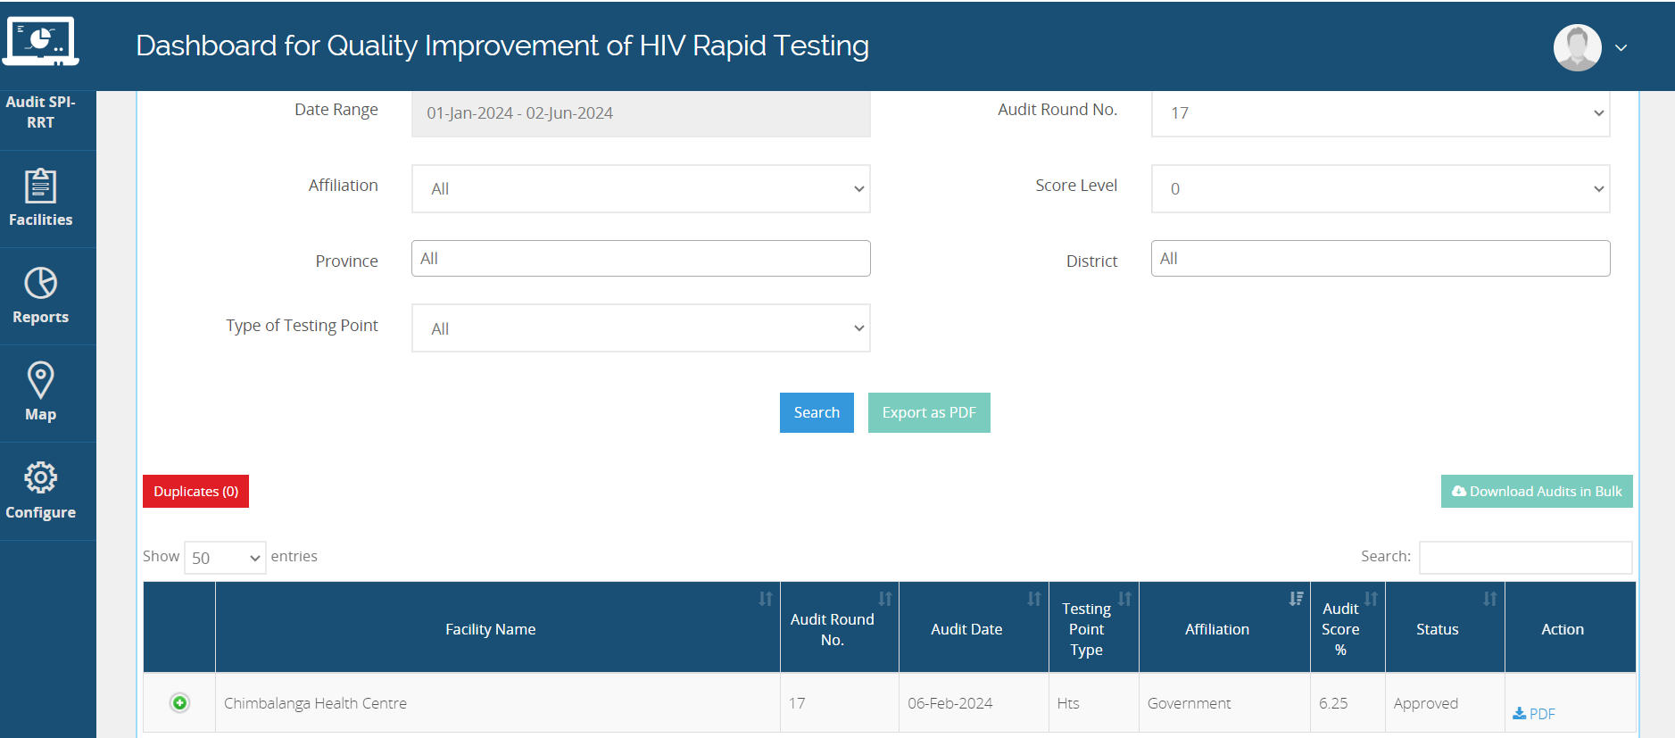
Data use in gap identification- SPI-RRT Level of performance
Review of progress of performance provides understanding on
  Poor performing sites
  Effectiveness of corrective actions/mentorship
  Challenges in assessment

Slide 17
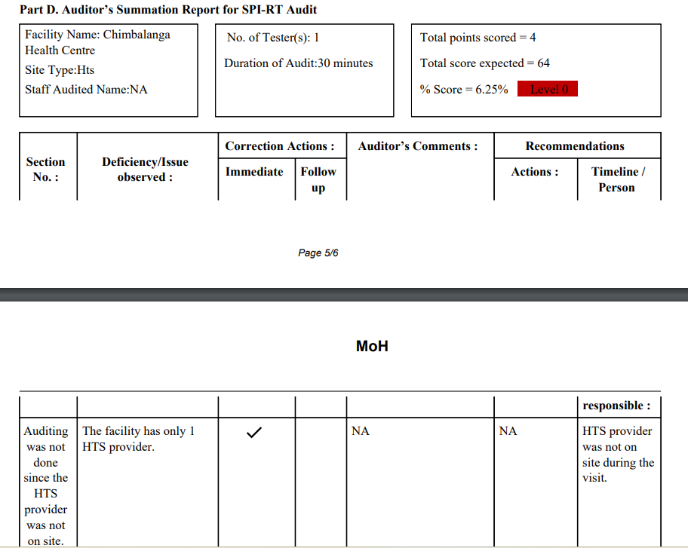
Example of SPI-RRT assessment gap

Slide 18
Data use to inform program progress
Comparison of baseline and follow up audits data with a right shift on level of performance
Reduction in the frequency of problems

Slide 19
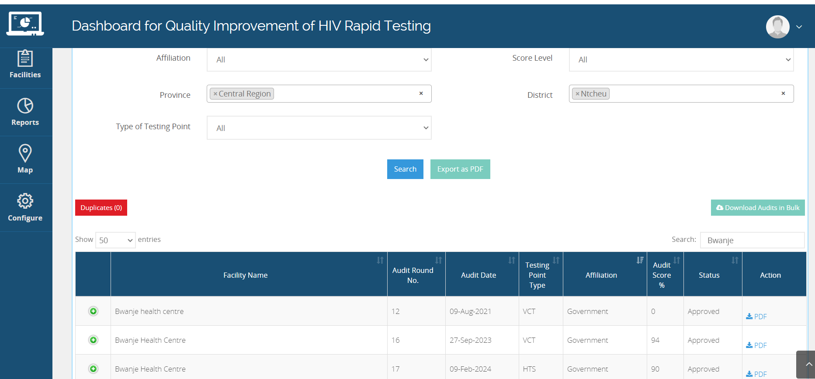
Data use to inform program progress
Comparison of site performance in all audits

Slide 20
Lessons learnt
Use of data at all levels informed decisions for planning and quality improvements
introduction of registry provides evidence of the work done
Use of technology such as ODK, scan form provides an efficient and effective data collection and use that shall be rolled out on various tools
Utilization of disaggregated regional and district data is effective and efficient for site and district capacity building on data monitoring

Slide 21


